Slide 2
Construct a Kohnen Self organizing map to cluster four given vectors [ 0 0 1 1 ] , [ 1 0 0 0], [0 1 1 0], [0 0 0 1]. Assume the number of clusters formed is two. Assume an initial learning rate of 0.5.

Slide 3
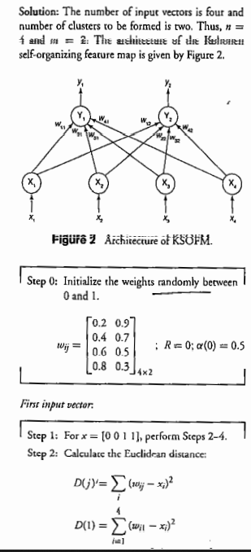
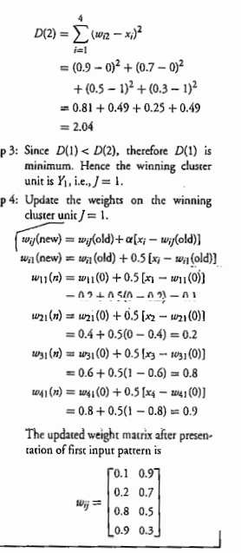


Slide 4
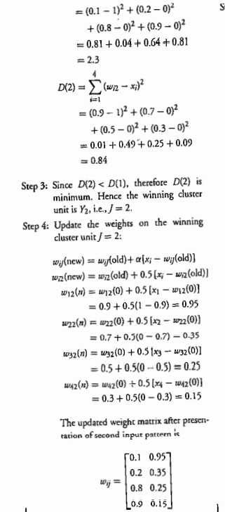
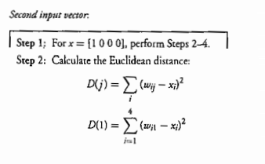

Slide 5
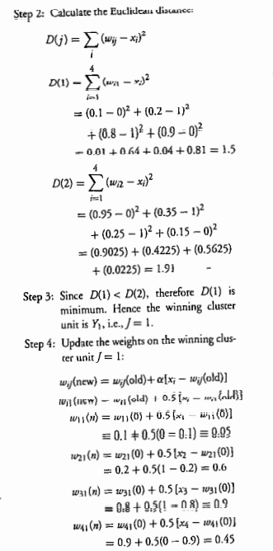
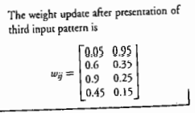
Third Input vector

